Slide 1
Issue to be solved:
We have similar functions like retrieve_workspace, get_dataset, etc(*) in some github repositories.
We need to minimize to re-create such functions
(*) https://github.com/microsoft/dstoolkit-classification-solution-accelerator/blob/main/src/utils.py
https://github.com/microsoft/dstoolkit-mlops-base/blob/main/src/utils.py
dstoolkit-classification-solution-accelerator
Are they same function?
Do I need to re-create func1?
new repo!
utils.py
def func1()
dstoolkit-XXX
dstoolkit-mlops-base
utils.py
def func1()
utils.py
def func1()
We don’t want to bother that such functions are the same? similar? not?
We don’t want to re-create the same functions in newly-generated repository.

Slide 2
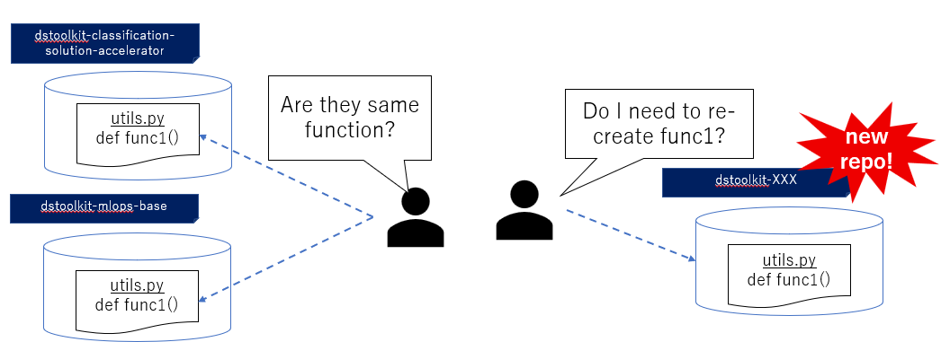
Basic concept: Need to extract same function from unique repository
Then, we call the common functions after “pip install”.
pip install dstoolkit-xx
dstoolkit-xx 1.0.0

Slide 3
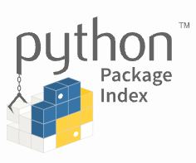
Solution 1: Register PyPI for existing repository & consume it from other repositories
dstoolkit-mlops-base
dstoolkit-classification-solution-accelerator
This example shows the case when “dstoolkit-ml-base” repository provides the common functions
utils.py
def func1()
register dstoolkit-ml-base
pip install dstoolkit-mlops-base
 | description
Pros | - No need to create another repository.
Cons | Need to prepare setup.py, etc to register into PyPI, which induce that the maintenance of the repository can be complicated.
dstoolkit-mlops-base 1.0.0

Slide 4
Solution 2: Register PyPI for new separate repository like “dstoolkit-common”
dstoolkit-classification-solution-accelerator
 | description
Pros | - Simple repository structure
Cons | Need to create new repository Who maintain it?
pip install dstoolkit-common
dstoolkit-mlops-common
utils.py
def func1()
dstoolkit-common 1.0.0
register dstoolkit-common

